Slide 1
Fluvial seismology
Presenting by Madhusudan Sharma
Indian Institute of Science
Many active Earth surface processes, such as landslides or sediment transport in flooding rivers can be challenging, costly and potentially dangerous to monitor.
Thanks to seismology !
Rivers, landslides , sediment transport etc. all transfer energy to the ground in the form of elastic or seismic waves. Traditionally considered “noise” by earthquake seismologists, these seismic signals contain valuable information about the processes that generated them and the ground through which they travel. By decoding these signals, we can use this information to characterize and study these processes.

Slide 2
Major Cause of fluvial seismicity
Landslides
Storms
Heavy Rainfall
Glacier melting
Main types of seismic sources
Debris flow
Bedload Transport
Fluid traction
Air water interaction

Slide 3
Type of information we decode from “Noise”
To identify the specific sources of seismic signals (e.g., waterfalls, landslides, etc.).
Characterizing the signals of water turbulence and sediment transport.
Characterize seismic wave attenuation properties in river .

Slide 4
Now we study some case study to understand Fluvial seismic source characteristic.

Slide 5
Analysis of seismic noise induced by rivers
A. Burtin et al. 2008
Aim of the analysis:
To found out the potential of using background seismic noise to quantify in continuous river bed load and monitor its spatial variations.
Data acquisition:
The data was used from (Hi-CLIMB), a project designed to image the lithospheric structures across the Himalayan collision zone. During this 3-year experiment, 115 broadband seismometers were deployed from southern Nepal to the Bang-gong suture in central Tibet along the Trisuli River.
Burtin used the data for the year 2003.
Location map shown ahead.

Slide 6
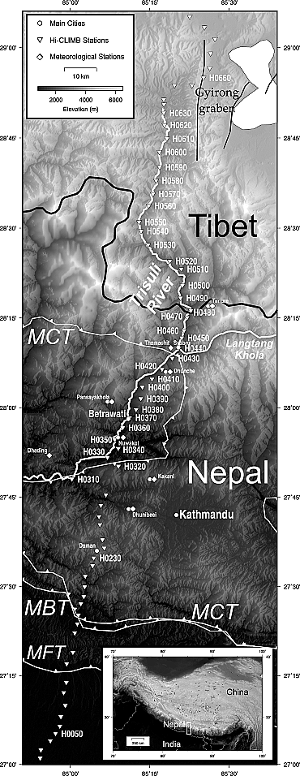

Slide 7
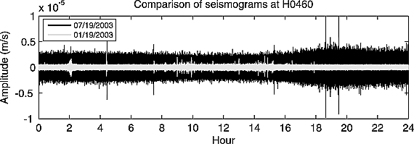
Observation 1
Comparison of two 1-d-long vertical seismograms recorded at station H0460. A full day of January (19 January 2003) and July (19 July 2003) are represented in white and black, respectively.
During summer, high-frequency noise is one order larger than during winter.
Daily variation of the noise during summer is also noticed, with larger noise amplitude at night than during the day.

Slide 8
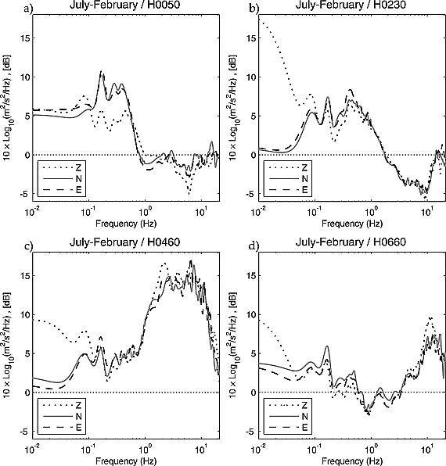
Observation 2
Seasonal Fluctuations
In the microseism band (0.1–1 Hz), stations H0050, H0230, and H0460 record larger energy amplitudes in July by about 5 to 10 dB .
Possible explanation: The enhancement of oceanic swell in Gulf of Bengal.
H0460 : (nearest to trisuli river)The noise amplitudes on the seismograms from station H0460 are then 6 times larger at high frequency during the monsoon period than during the dry season. A similar observation was made at most stations located along the Trisuli River.
Possible explanation: ??
Seasonal fluctuation of seismic noise: obtained by subtracting the average July PSD to the average February PSD for 2003 at stations (a) H0050, (b) H0230, (c) H0460, and (d) H0660.

Slide 9
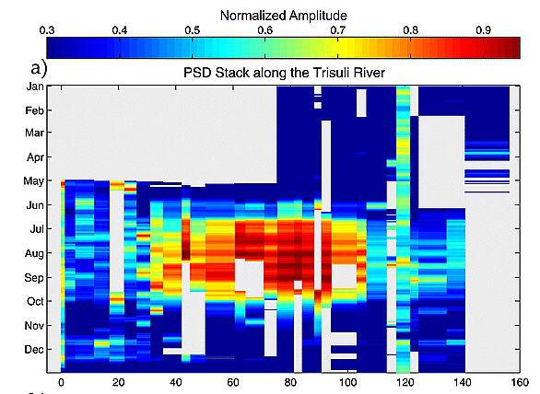
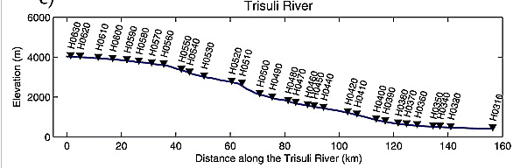
Observation 3
Strong increase of the high- frequency energy (>1 Hz), from stations H0410 to H0560 from June to September.
For these stations, the level of noise shows a first increase at the end of May lasting until mid-June.
Then, the energy reveals a second increase and reaches an almost constant level until the end of September with intermittent peaks that are well correlated between stations.
The time period of energy enhancement coincides with the summer monsoon period in Nepal.
Mean vertical PSDs at Hi-CLIMB stations along the Trisuli River.
Location of the Hi-CLIMB stations (downward black triangles) projected on the elevation profile of the Trisuli river.

Slide 10
What do you think could be the possible explanation for this type of seismicity?
More amp during July at seismometer near river?
Monsoon started from mid June but seismicity increase from may , why?
High PSD at seismic stations along Trisuli river?
High seismicity during night than day?
Anthropogenic source ??
Glacial melt (seasonal fluctuation) ??
Precipitation ??
Water level of river ??
Bed-load transport ??
Any other idea??
Let’s see which one or more may be the possible reason...

Slide 11
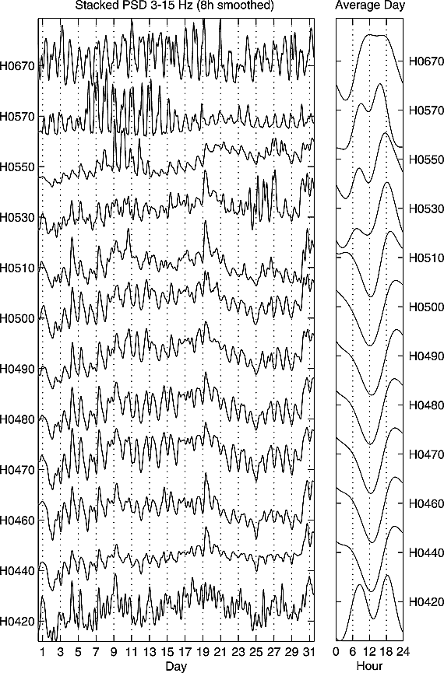
Possibility of Anthropogenic source
(a) PSDs stacked over a frequency band of 3–15 Hz for July 2003.

Slide 12
This 24-h cycle has a minimum amplitude reached at 01 pm and a maximum amplitude late in the evening.
This suggests that the source responsible for this seismic noise is anticorrelated with the possible sources of anthropogenic noise, which has a minimum at night.
(a) PSDs stacked over a frequency band of 3–15 Hz for July 2003 and for a set of Hi‐CLIMB stations from north to south, top to bottom, respectively. (b) Corresponding mean daily noise level variations calculated by summing 24‐h‐long segments of the curves

Slide 13
What do you think could be the possible explanation for this type of seismicity?
More amp during July at seismometer near river?
Monsoon started from mid June but seismicity increase from may , why?
High PSD at seismic stations along Trisuli river?
High seismicity during night than day?
Anthropogenic source
Glacial melt (seasonal fluctuation) ??
Precipitation ??
Water level of river ??
Bed-load transport ??
Any other idea??

Slide 14
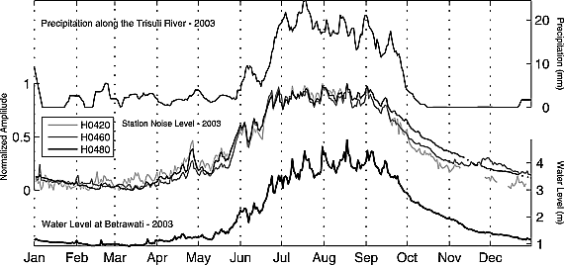
Comparison of local meteorological and hydrological data with the noise level curves
Top curve is the 10-d centered moving average of the daily precipitation rate in mm for year 2003 at 8 meteorological stations from the Department of Hydrology and Meteorology of Nepal (DHM) located along the valley of the Trisuli River.
Middle curves are the high-frequency noise level (averaged over the three components and the frequency band 3–15 Hz for year 2003) at stations H0420, H0460, and H0480.
Bottom curve is the Trisuli water level in meters measured at the town of Betrawati near station H0370 during year 2003.

Slide 15
From January to May the precipitation in the region are rare and weak meanwhile the noise level is low. However, the noise level time series does not correlate with the rare local rainfall.
In June at the onset of the monsoon season, the precipitation rate increases and remains at the highest levels of the year until the end of September. In June, seismic noise at the observed stations increases rapidly, reaching an amplitude threshold for the following three months.
At the end of September, the precipitation rates depict a sudden decrease whereas the recession of ambient noise is gentler.
Peaks of noise level during the monsoon period are not well in phase with peaks of precipitation.
Correlation coefficient between noise amplitude at H0460 with precipitation is 0.61.

Slide 16
What do you think could be the possible explanation for this type of seismicity?
More amp during July at seismometer near river?
Monsoon started from mid June but seismicity increase from may , why?
High PSD at seismic stations along Trisuli river?
High seismicity during night than day?
Anthropogenic source
Glacial melt (seasonal fluctuation) ??
Precipitation
Water level of river ??
Bed-load transport ??
Any other idea??

Slide 17
Water discharge through Trisuli river was continuously monitored and we find-
Gentle increase of discharge from April to May.
Rapid augmentation in June due to the fast melting of snow and ice in glaciers in response to increased air temperature.
In July and August, discharge rates reach the largest values.
September to October- period of rapid discharge recession.
Whereas from November to March the discharge decreases only slightly.
During the monsoon period, the time series of both data sets is well correlated.
The correlation coefficient between H0460 seismic noise and water level is 0.86, whereas it is only 0.61 with precipitation.

Slide 18
What do you think could be the possible explanation for this type of seismicity?
More amp during July at seismometer near river?
Monsoon started from mid June but seismicity increase from may , why?
High PSD at seismic stations along Trisuli river?
High seismicity during night than day?
Anthropogenic source
Glacial melt (seasonal fluctuation)
Precipitation
Water level of river
Bed-load transport ??
Any other idea??

Slide 19
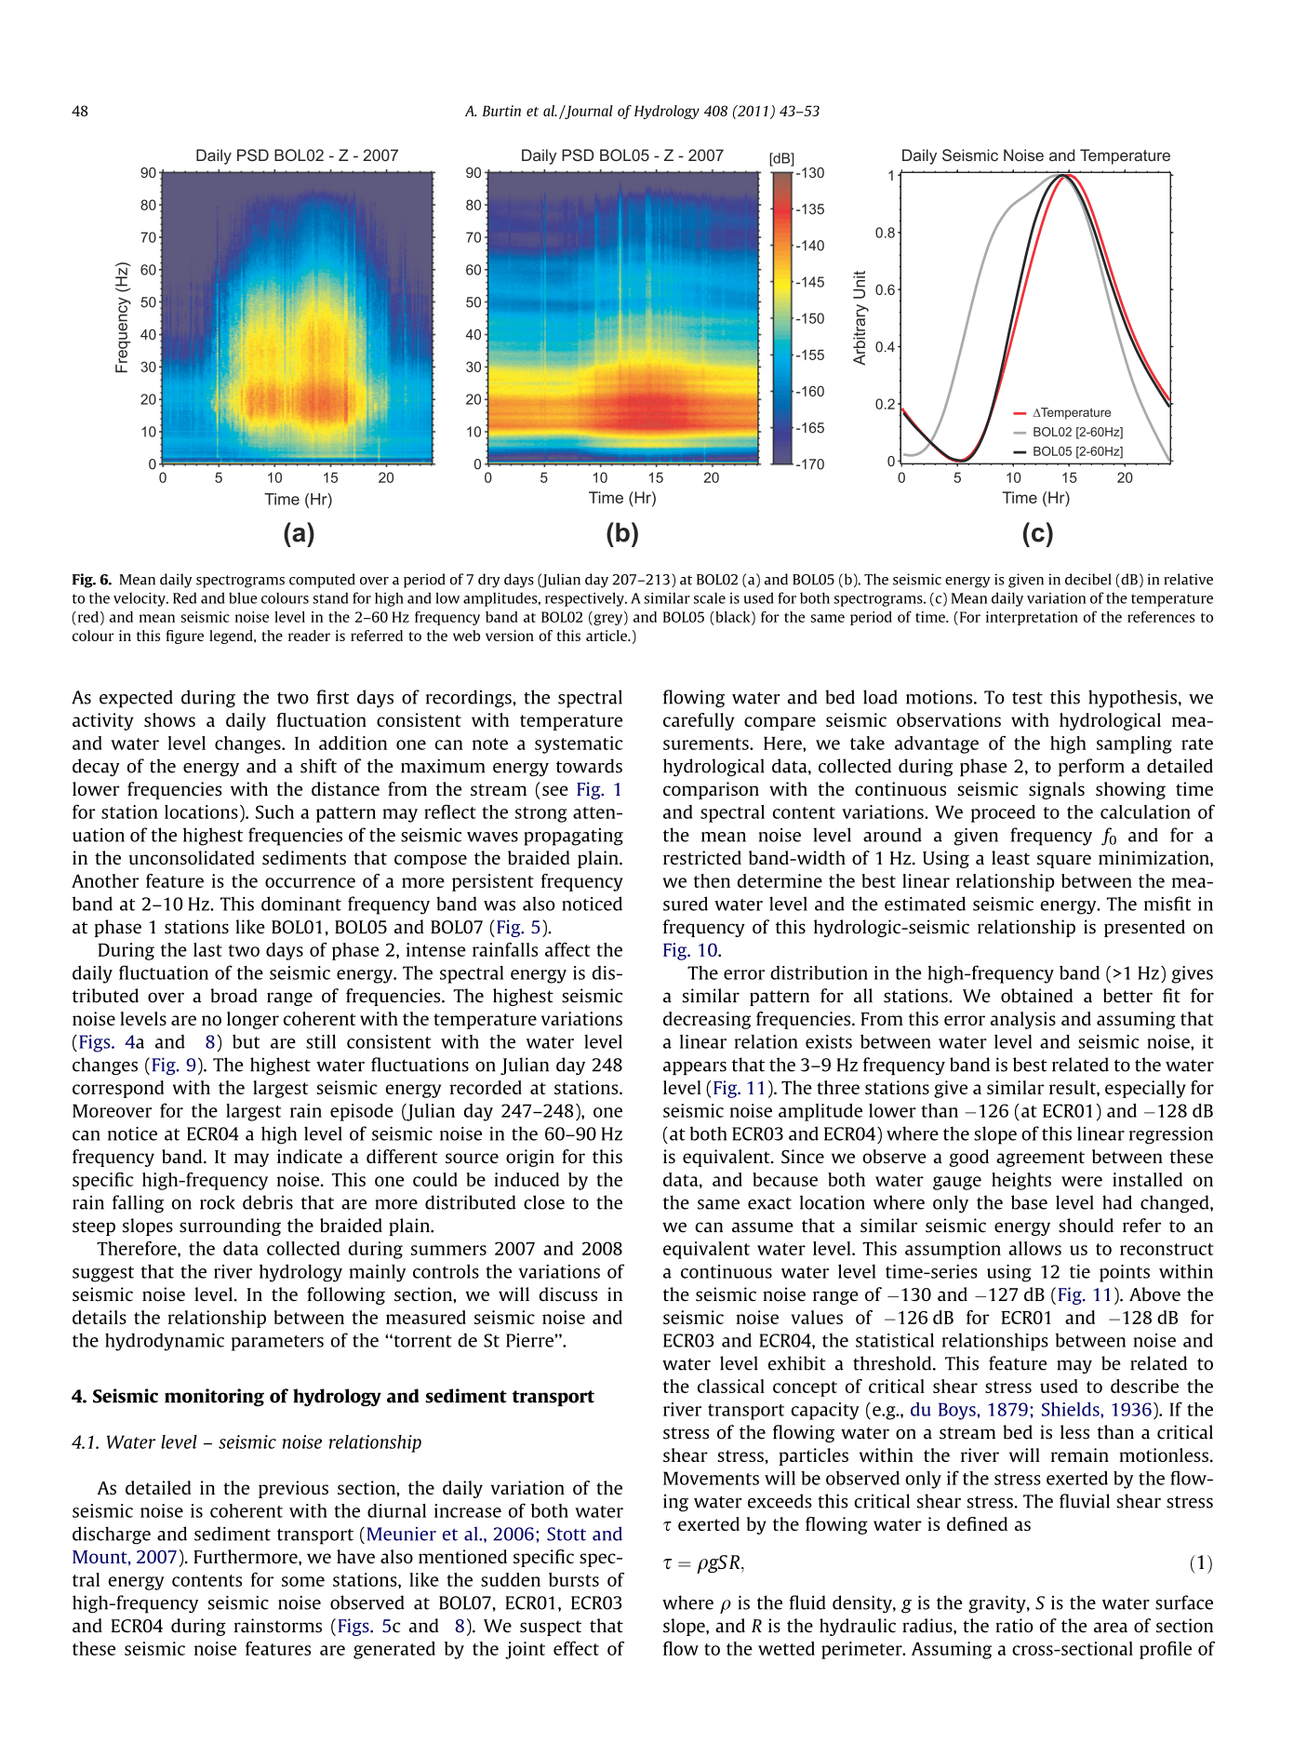
River is going narrow on upstream while in downstream area river is wider.
Hydraulic radius increases in upstream
Fluvial stress increases
2. We see that slope gradient is steep in between H0510 TO H0410 than northern and southern.
Slope increases
Fluvial stress increases
Increase in fluvial stress leads to
bedload transport .

Slide 20
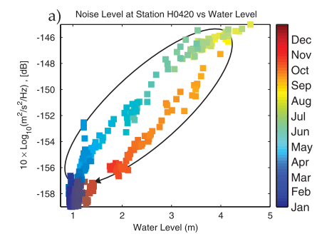
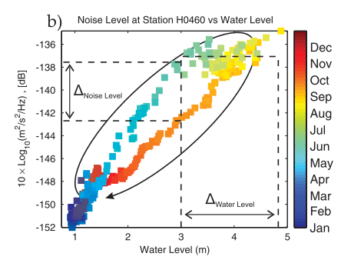
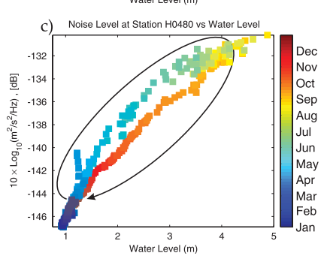
Characteristic of bedload transport signature
For equivalent water level the amplitude of noise recorded at the beginning of the monsoon (June to July) is larger than the one recorded at the end of the rain season (September to October).
part of the available bed load at the beginning of the rainfall season have been used or removed at the end of the monsoon, which leads to a decrease in the river- generated seismic noise, since only the largest boulders remain available to produce noise
From July to August, despite a constant increase in water level (from 3.25 to 5 m), the amplitude of the noise remains almost constant (<2 dB).
Mean daily noise level amplitudes at station (a) H0420, (b) H0460, and (c) H0480 compared to the daily water level of the Trisuli River measured at Betrawati during year 2003. Each square represents 1 d, and its color indicates month of the year. The observed hysteresis progression is indicated by the black arrow curve.

Slide 21
What do you think could be the possible explanation for this type of seismicity?
More amp during July at seismometer near river?
Monsoon started from mid June but seismicity increase from may , why?
High PSD at seismic stations along Trisuli river?
High seismicity during night than day?
Anthropogenic source
Glacial melt (seasonal fluctuation)
Precipitation
Water level of river
Bed-load transport
Any other idea ??

Slide 22
Explanation for High seismicity at night
Ueno et al. [2001] show a remarkably periodic diurnal cycle during the summer monsoon. The total amount of precipitation from 04 pm to 06 am corresponds to 88% of the daily total amount.
Daily variation of discharge measurements seem to be well correlated with our observations of noise levels at seismic stations close to the Trisuli River.

Slide 23
What do you think could be the possible explanation for this type of seismicity?
More amp during July at seismometer near river?
Monsoon started from mid June but seismicity increase from may , why?
High PSD at seismic stations along Trisuli river?
High seismicity during night than day?
Anthropogenic source
Glacial melt (seasonal fluctuation)
Precipitation
Water level of river
Bed-load transport
Any other idea – Regional characteristic (precipitation more at night).

Slide 24
Control Flood Experiment- Grand Canyon
Schmandt et al. 2013
Field site - Eastern grand canyon .
Location of seismometer - 32 and 38m from the channel edge during peak
discharge and minimum discharge respectively.
Instruments - Three component ground velocity was measured by an L-22
seismometer with a corner frequency of 2 Hz and flat response
to >>100 Hz.

Slide 25
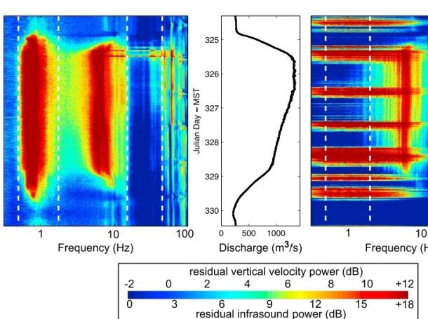
Spectral analysis
0.5hz
2hz
15hz
45hz
The lowest frequency band excited by the CFE is 0.5–2 Hz, with a maximum increase of 17 dB at 0.73 Hz.
A second local maximum of 14 dB increase occurs at 6.25 Hz.
Frequencies from about 10–45 Hz show bursts of elevated power during near the end of the CFE’s rising limb.
Two peaks in the residual seismic spectrum remain prominent throughout the duration of the CFE, while frequencies between about 15–45 Hz are strongly excited during the rising limb but not the descending limb.

Slide 26
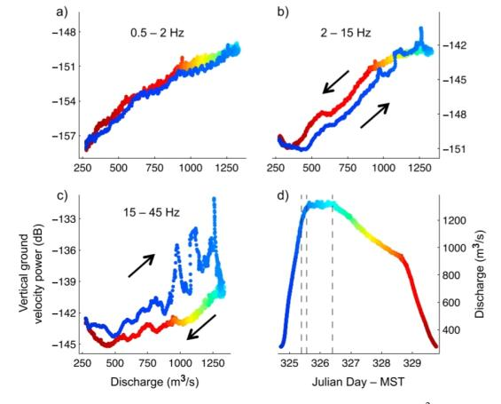
Observed signature of fluvial seismic sources
1.
We consider the 15–45 Hz power variations to be dominantly driven by bed-load transports.
This attribution is suggested by strong clockwise hysteresis.
We also see in rising limb three episodes with 4–5dB power increases .
we predict in this model the episodes with 4–5 dB power increases would correspond to transient increases in bed-load flux by a factor of 2.5–3.2, and the 9 dB drop in power at the end of the rising limb would correspond to an abrupt eightfold decrease in bed-load flux.

Slide 27
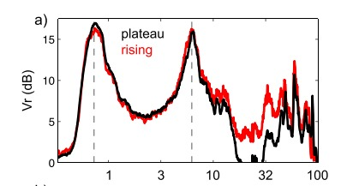
Seismic signal of bedload transport
Frequency( hz)
We consider 15-45 hz power variation dominated by bedload transport .
In that range the power of seismic signal during rising limb is clearly distinguish with plateau.

Slide 28
Seismicity Due To Fluid Traction
Vertical ground velocity power
(dB)
Discharge(m^3/s)
Smooth power variations with discharge and lack of hysteresis are consistent with a fluid flow source.

Slide 29
Seismic Response Due to Air- Water Interaction
Vertical ground velocity power
(dB)
Discharge(m^3/s)
Seismic power in the 2–15 Hz band exhibits counter-clockwise hysteresis.
If waves at the fluid-air interface are primarily responsible for power in this band, the difference at intermediate discharge levels could represent a modest change in the water wave pattern owing to bed-load movement during peak discharge.

Slide 30
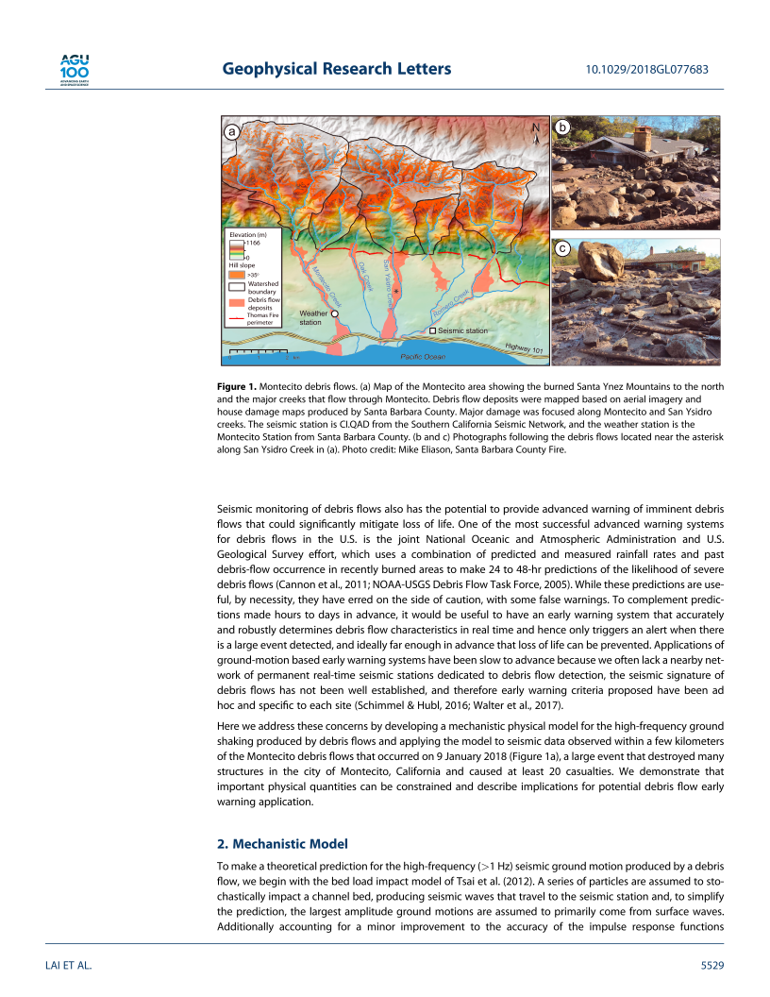
Case study – Debris Flow At Montecito, California
Lai et al. 2018
Seismic station used in this analysis is located within ~250 m of Romero Creek and ~1.5 km of the zone of major damage near San Ysidro Creek.
There was a large wildfire on the hills. The first heavy rainfall after the wildfire caused heavy debris flow downwards.

Slide 31
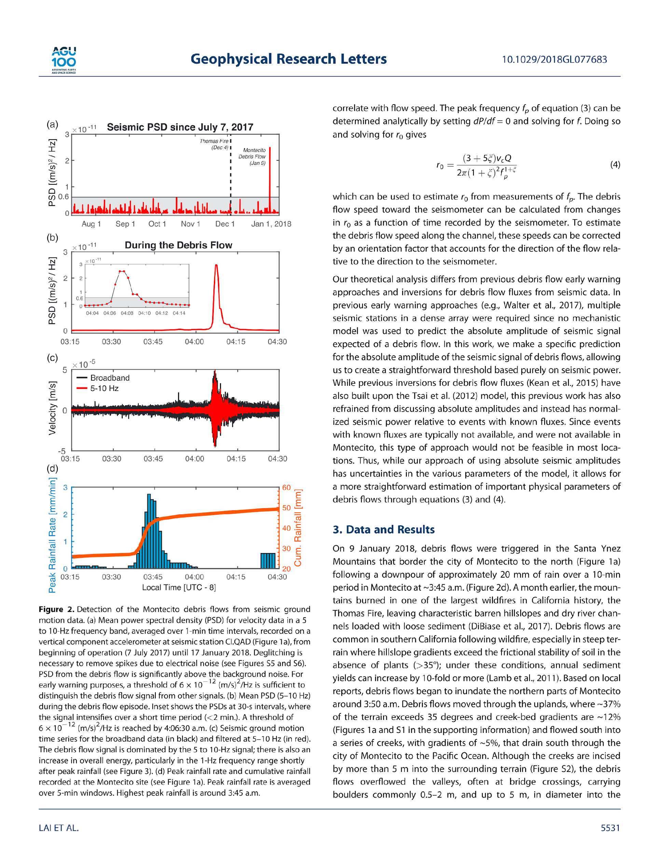
Seismic Signature of Debris Flow
Ground motion amplitude exceeding 6 × 10e(-12) (m/s)2/Hz accurately discriminates between the Montecito debris flows and any other event.
Ground motion velocities of 5-10hz with amplitudes in excess of 10e(-5)m/s lasting more than 10 min .

Slide 32
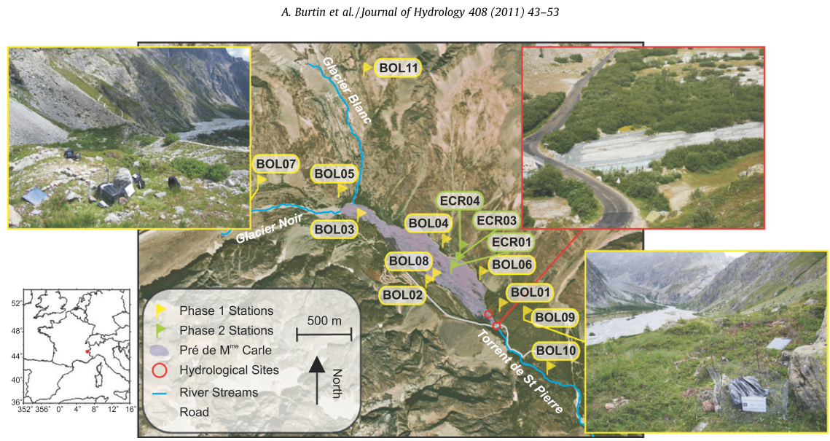
Establish Relation Between HYDROLOGY AND SEISMOLOGY
Case Study - Braided River(‘‘torrent de St Pierre’’, French Alps)

Slide 33
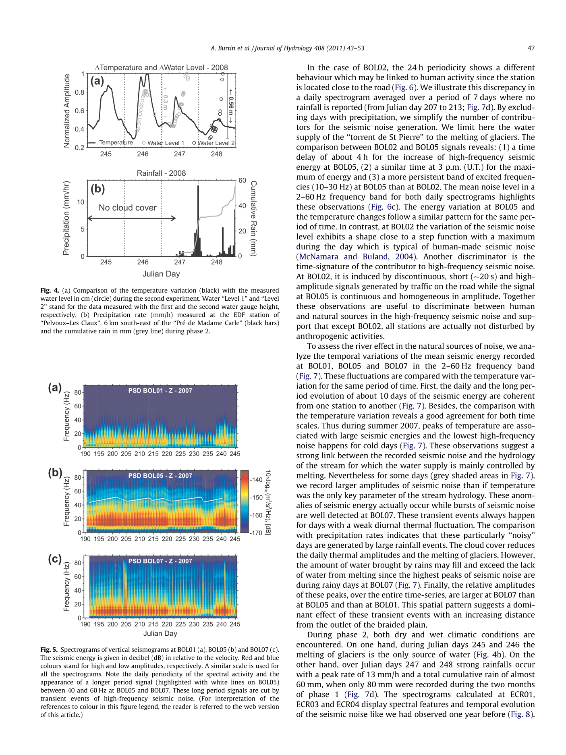
Spectral Analysis
PHASE 1
The spectrograms at BOL01, BOL05 and BOL07 depict a 24 h fluctuation of the seismic energy in the frequency range 2–40 Hz.
Long period trends are interrupted by strong bursts of high-frequency seismic noise that are well revealed at BOL07.

Slide 34
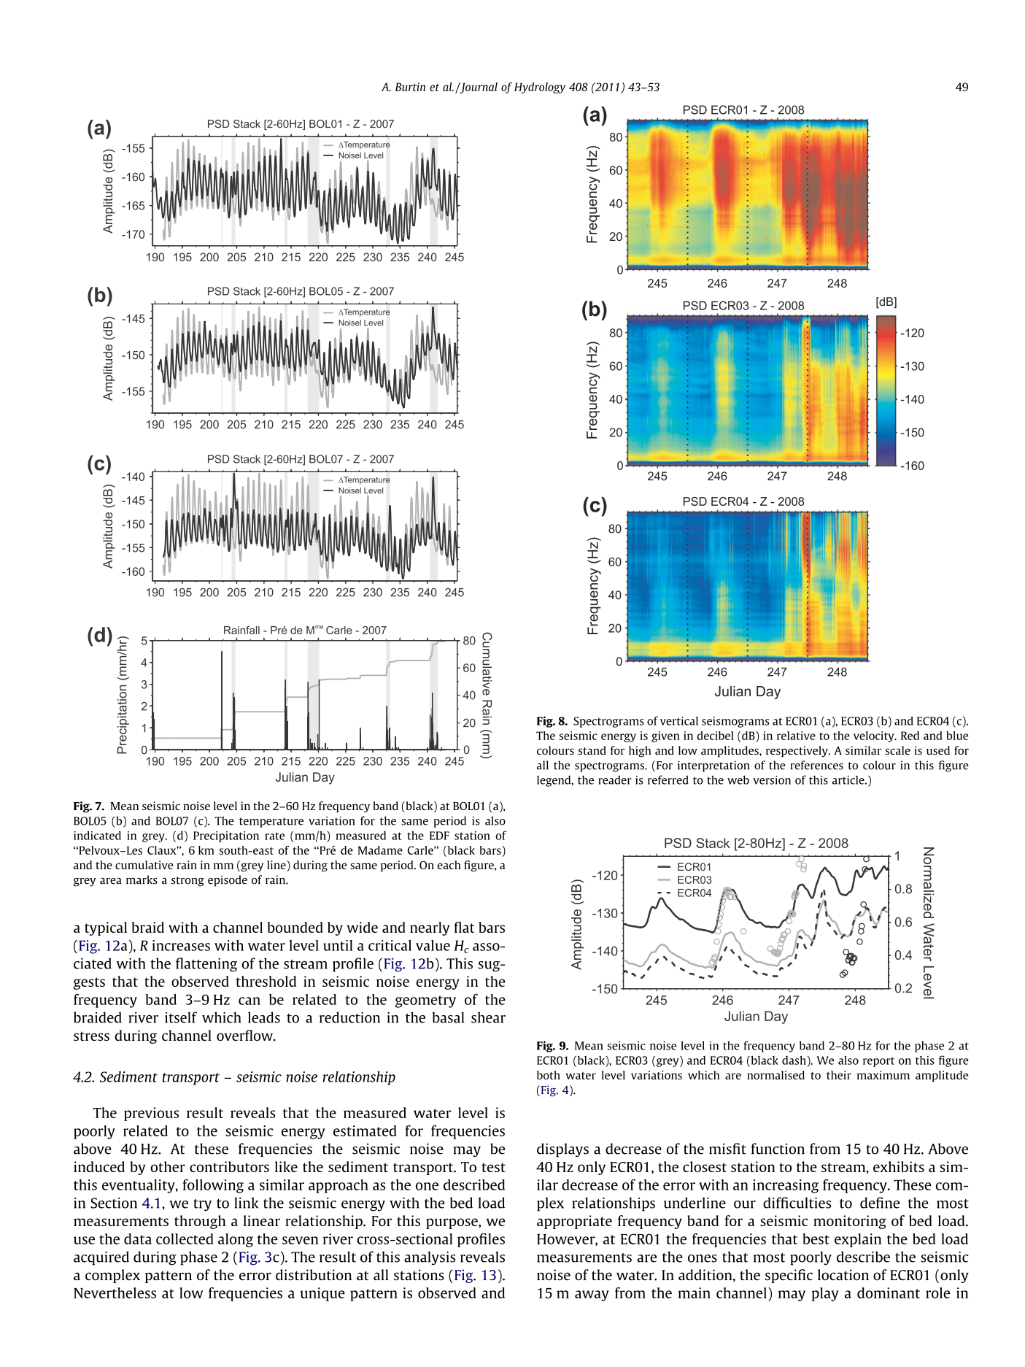
Seismicity Vs Temperature variation
These observations suggest a strong link between the recorded seismic noise and the hydrology of the stream for which the water supply is mainly controlled by melting.
In grey shaded area, we record larger amplitudes of seismic noise than if temperature was the only key parameter of the stream hydrology. These anomalies of seismic energy actually occur while bursts of seismic noise are well detected at BOL07
The comparison with precipitation rates indicates that these particularly ‘‘noisy’’ days are generated by large rainfall events.

Slide 35
PHASE 2
Glacial melting only source of water on 245and 246 days.
On 247 and 248 heavy rainfall occur.
We also see that high frequency energy attenuate with distance . May be because of unconsolidated sediment that compose the braided plain.
We see energy between 60-90 hz frequency , this is because of rain falling on rock debris.

Slide 36
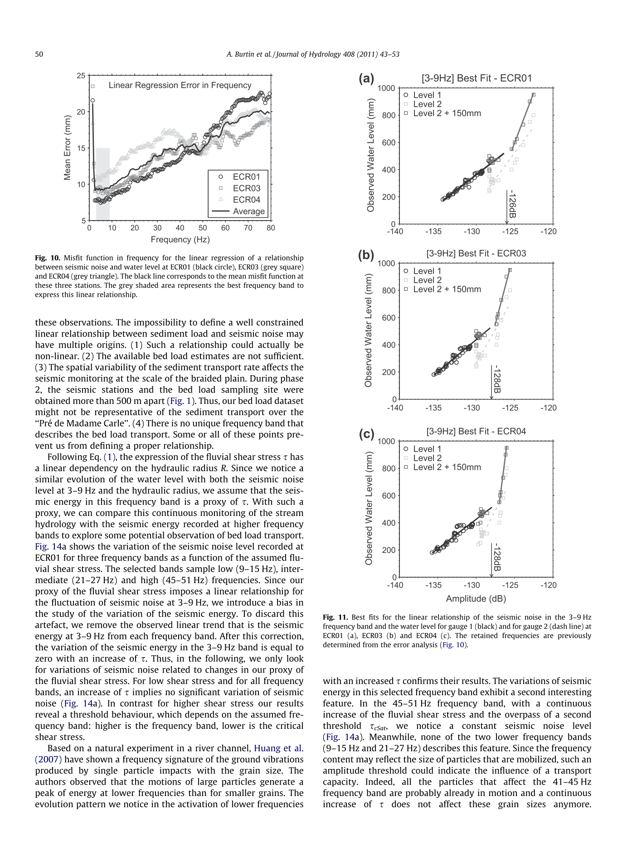
Hydrologic – Seismic Relationship

Slide 37
Observation
It appears that the 3–9 Hz frequency band is best related to the water level . The three stations give a similar result, especially for seismic noise amplitude lower than -126 (at ECR01) and -128 dB (at both ECR03 and ECR04) where the slope of this linear regression is equivalent.
Above the seismic noise values of -126 dB for ECR01 and -128 dB for ECR03 and ECR04, the statistical relationships between noise and water level exhibit a threshold.
Explanation
This feature may be related to the classical concept of critical shear stress used to describe the river transport capacity . If the stress of the flowing water on a stream bed is less than a critical shear stress, particles within the river will remain motionless. Movements will be observed only if the stress exerted by the flowing water exceeds this critical shear stress.
The fluvial shear stress exerted by the flowing water is defined as
R = Hydraulic Radius
S = Slope
p = density of fluid

Slide 38
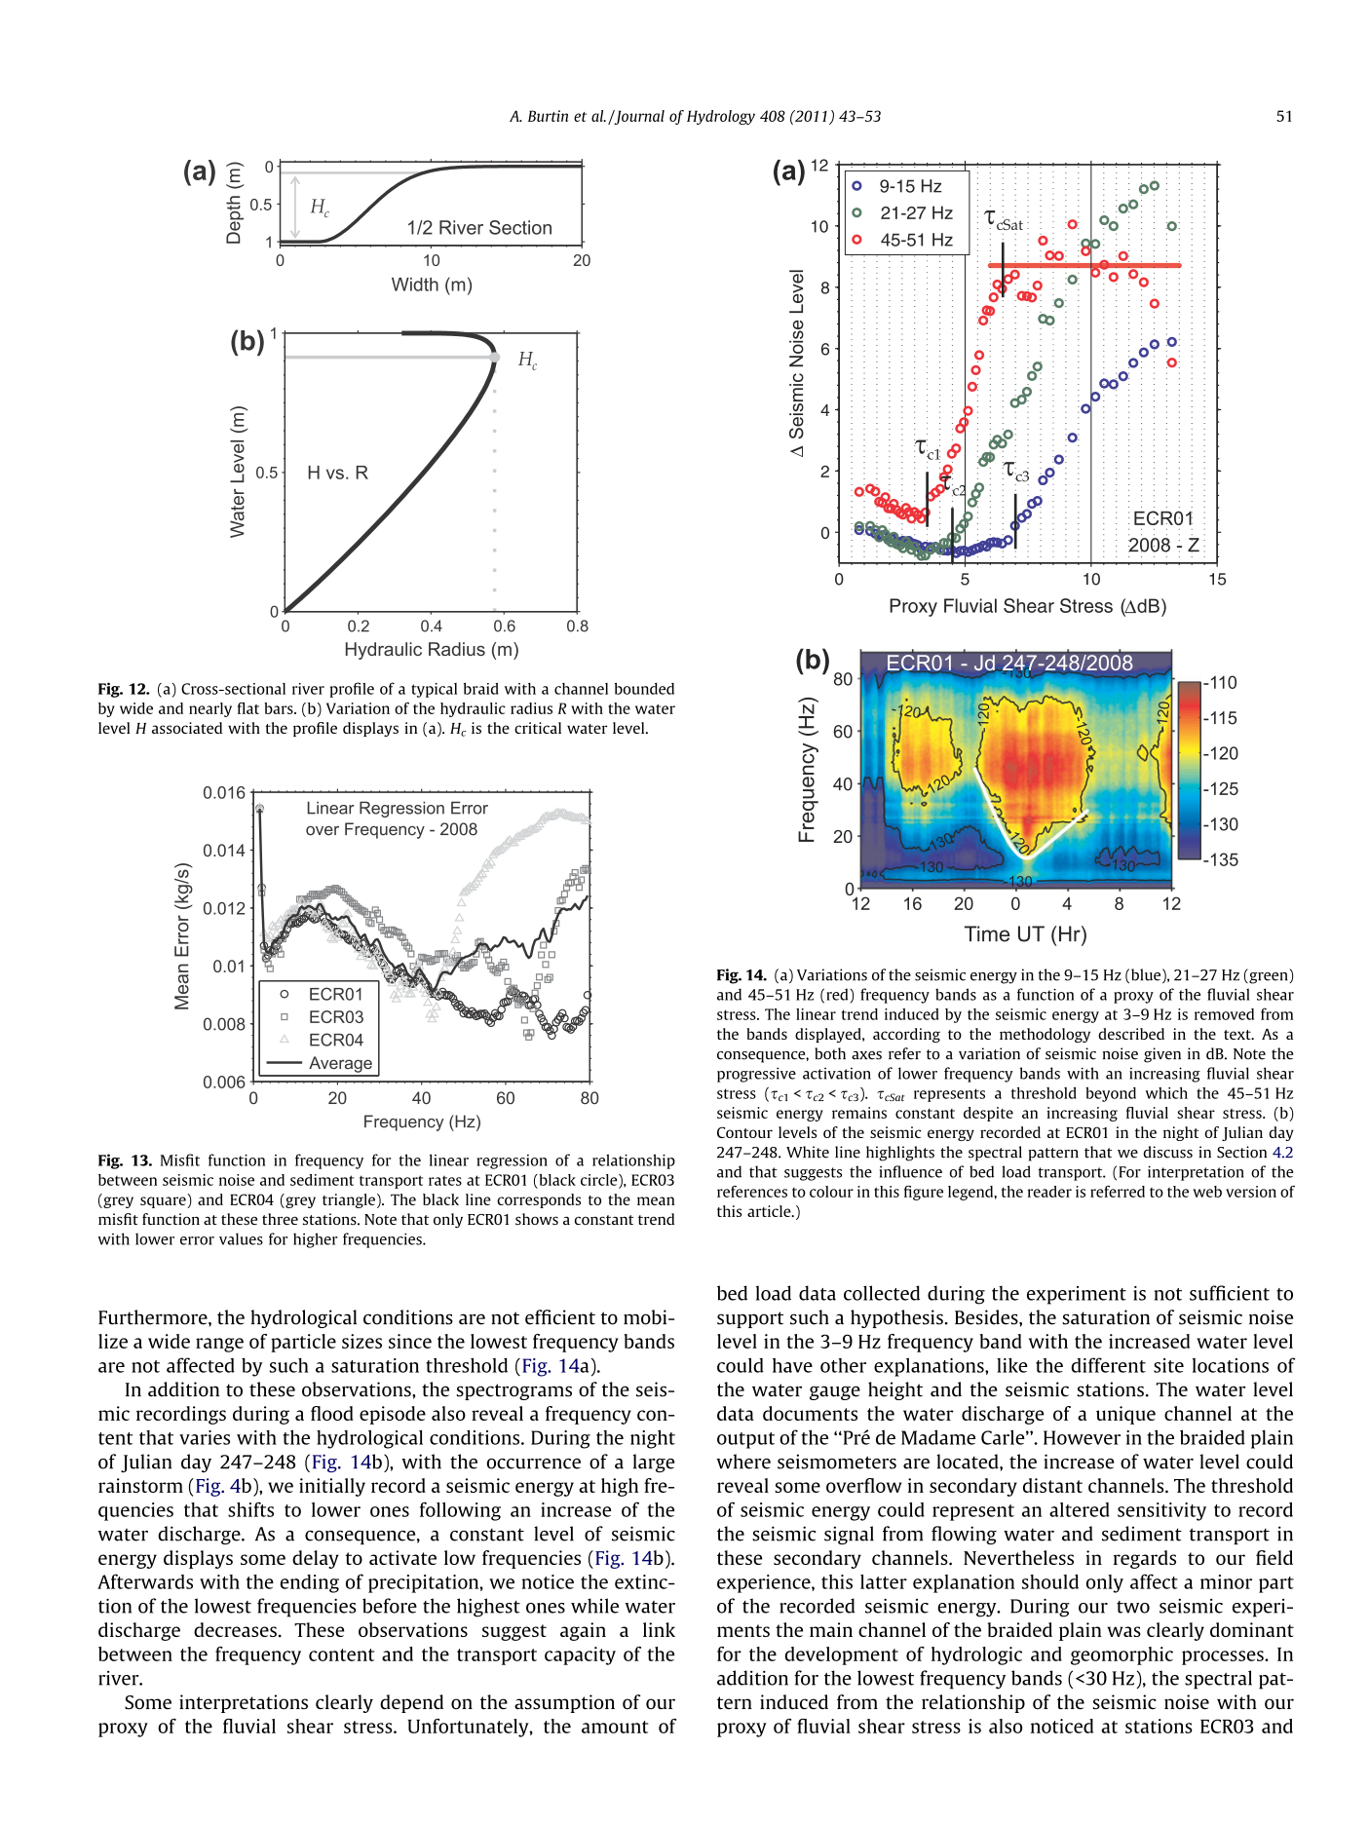
Sediment – Seismic Relationship
We see that for lower frequency band critical stress is greater while for higher frequency band critical stress is lesser.
In the 45–51 Hz frequency band, with a continuous increase of the fluvial shear stress and the overpass of a second threshold , we notice a constant seismic noise level

Slide 39
During the night of Julian day 247–248 , with the occurrence of a large rainstorm , we initially record a seismic energy at high frequencies that shifts to lower ones following an increase of the water discharge. As a consequence, a constant level of seismic energy displays some delay to activate low frequencies . Afterwards with the ending of precipitation, we notice the extinction of the lowest frequencies before the highest ones while water discharge decreases. These observations suggest again a link between the frequency content and the transport capacity of the river.

Slide 40
Conclusion
We show that an increase of water supply leads to an enhanced transport capacity of the stream that mobilizes the largest particles. Hence, the spectrograms exhibit a frequency content that shifts to lower frequencies, and agree with a relationship between the frequency content of the ground vibrations and the grain size of bed load.

Slide 41
Now, we have the methods of identifying bed-load transport as the ‘’hysteresis’’. But is this signature enough to predict the flood or amount of sediments coming downstream?
We don’t have much models to relate the observed seismic quantities with the amount of sediment flux.
Until we have good correlation between sediments and seismic data we cannot use it to predict flood or debris.
Tsai et al. 2012 has developed a physical model to describe the seismic noise induced by the transport of sediment in rivers.
According to this model, we use PSD of the Rayleigh waves generated by impulsive impacts of saltating particles.
This PSD of Rayleigh waves depends on-
Size of particles
Number of particles of given size
Square of linear momentum.

Slide 42
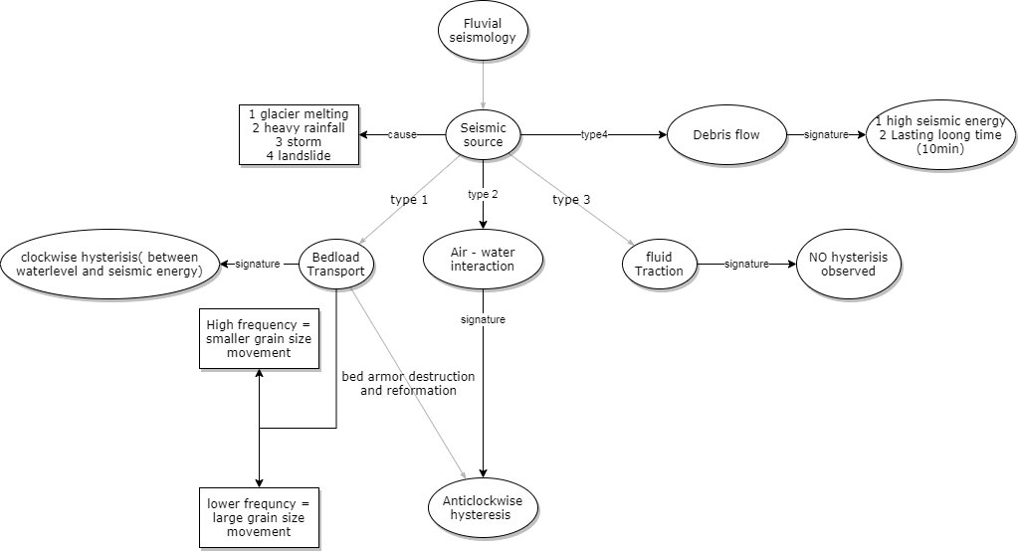
Overview

Slide 43
Presenting study from -
• Burtin, A., Bollinger, L., Vergne, J., Cattin, R., and Nábělek, J. L. (2008), Spectral analysis of seismic noise induced by rivers: A new tool to monitor spatiotemporal changes in stream hydrodynamics, J. Geophys. Res., 113, B05301, doi:10.1029/2007JB005034.

